Slide 1

Team 2: BoraDiTo Co.
CEO Travis Borten
Chief Engineer Dominic DiTomaso

Slide 2

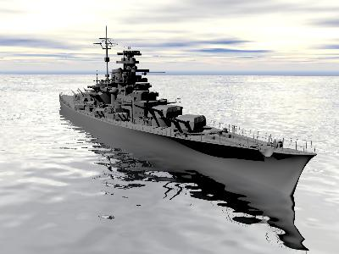
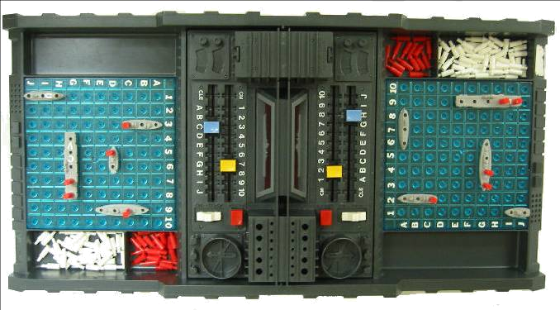
Project Goals
To Design & Make playable version of the famous game Battleship.
  Based off of classic battleship Game play
  Entertaining
  Feasible
  Challenging

Slide 3
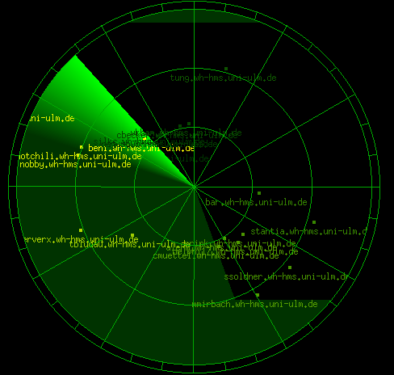
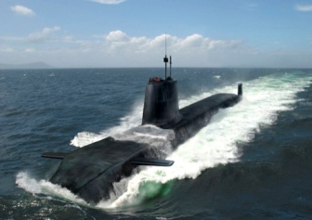
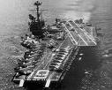
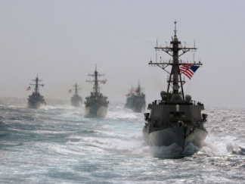


Product Description
13 different functions
4 Separate GUI figures
  Battleship Splash Screen
  Navigation - Select Ships
  Arena – Main figure
  Game Stats & Result
Over 3,400 lines of code
Realistic explosion sounds
Animated missile
Battlefield statistics
Computer Opponent with Artificial Intelligence

Slide 4
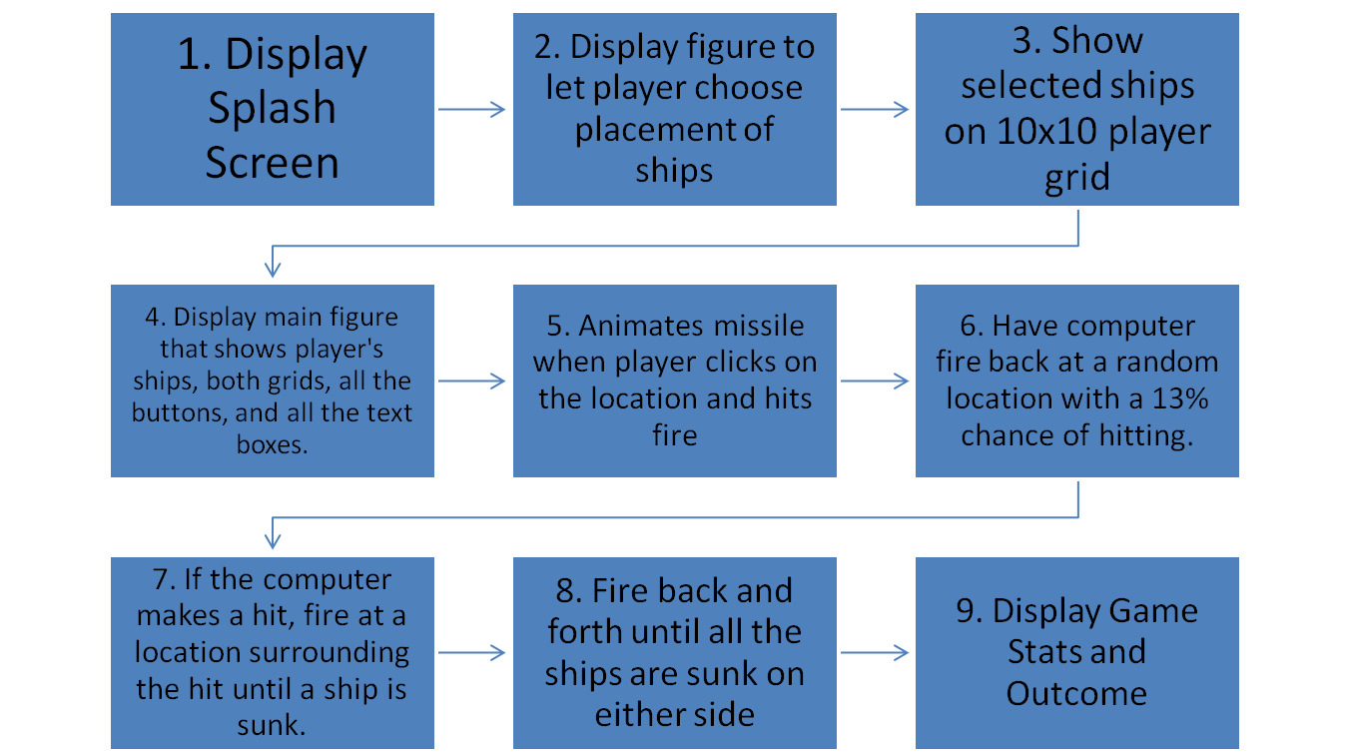
Software Design

Slide 5
The Fire Button
% --- Executes on button press in fire.
function fire_Callback(hObject, eventdata, handles)
% hObject handle to fire (see GCBO)
% eventdata reserved - to be defined in a future version of MATLAB
% handles structure with handles and user data (see GUIDATA)
% change fire button background color back to grey
set(hObject,'BackgroundColor',[.8353 .8157 .7843])
set(hObject,'Enable','off') % disable fire button
% store the value in the 10x10 matrix at the position fired on the comp grid
handles.cstatus = handles.cgrid(handles.rowLoc,handles.colLoc);
guidata(hObject,handles)
% fire the player's missile at the spot chosen
handles=pfire_missile(hObject,handles);
if handles.cstatus % if the player hit one of the computer's ships
handles.cgrid(handles.rowLoc,handles.colLoc)=6; % change the value in the computer's 10x10 matrix to 6
guidata(hObject,handles) % update
set(handles.display,'String','You HIT the computer ship','FontSize',10) % display hit next to fire button
handles = is_csunk(hObject,handles); % check to see if a computer's ship was sunk
set(handles.lastVisHand,'BackgroundColor','r') % change the grid button to red
set(handles.lastVisHand,'Enable','off') % disable the grid button
else % if it is a miss change to white and disable
set(handles.lastVisHand,'BackgroundColor',[1 1 1])
set(handles.lastVisHand,'Enable','off')
set(handles.display,'String','You missed the computer ship','FontSize',10)
end
% tell comp to fire
pause(.5)
handles=comp_fire(hObject,handles);

Slide 6
Team 2: BoraDiTo Co.
CEO Travis Borten
Chief Engineer Dominic DiTomaso

